Slide 1
Diseases Associated Variants
Ali Banijamali

Slide 2
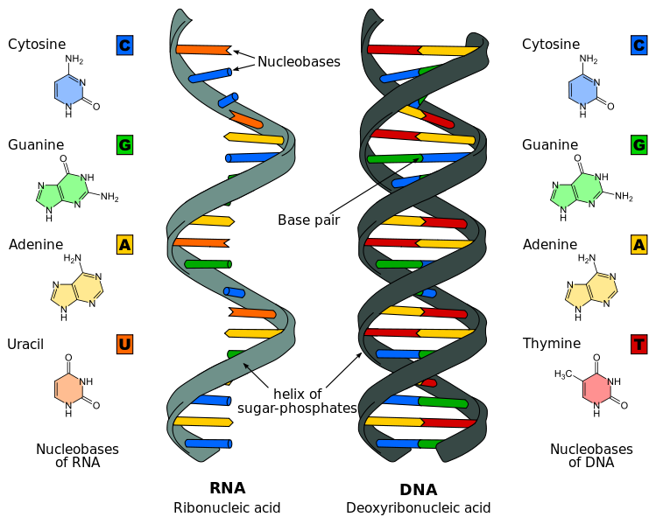
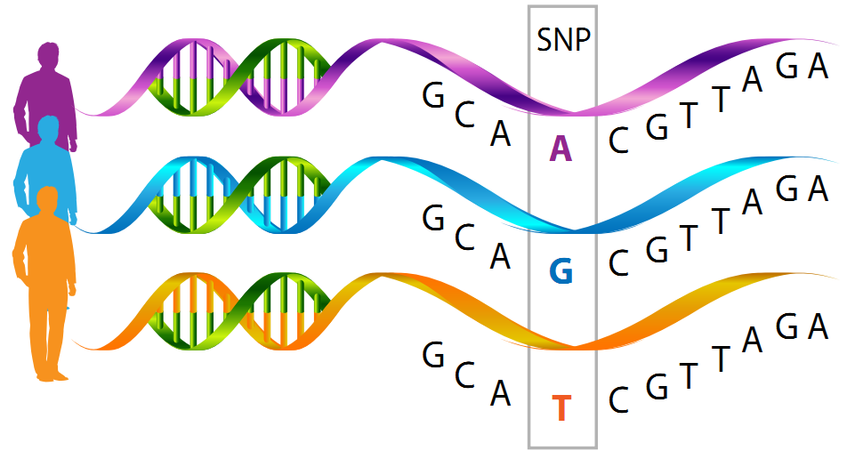
DNA | Gene | SNP
DeoxyriboNucleic Acid
Single Nucleotide Polymorphism
[2]
[1]
A wide range of human diseases result from SNPs.

Slide 3
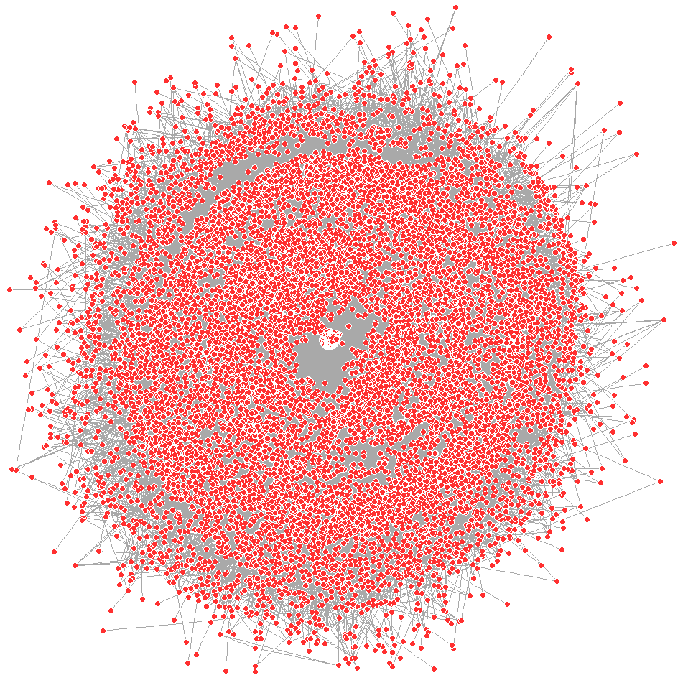
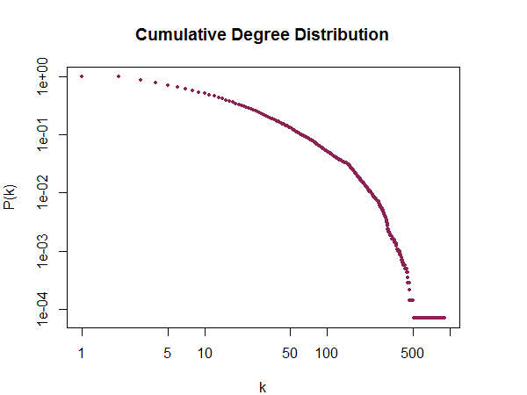
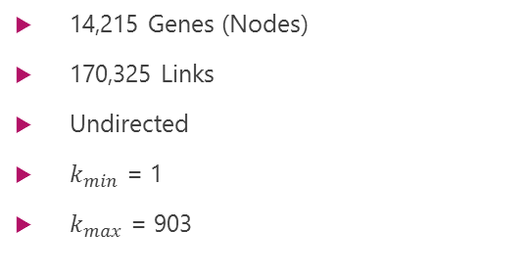
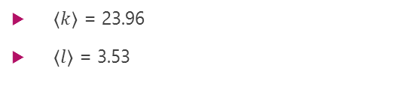
Data sets – PPI
Protein Protein Interaction
Gene 1 | Gene 2
A1BG | ANXA7
A1BG | CDKN1A
A1BG | GRB7
A1BG | SMN1
A1BG | SNCA
A1BG | TK1
A1BG | CRISP3
A2M | AMBP
A2M | ANXA6
14,215 Genes (Nodes)
170,325 Links
Undirected
$k_{min}$ = 1
$k_{max}$ = 903
$\left\langle k\right\rangle$ = 23.96
$\left\langle l\right\rangle$ = 3.53

Slide 4
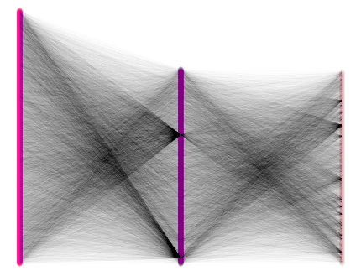
Data sets – GWAS
Genome Wide Association Study
SNP | Genes | Trait / Disease
rs3934834 | NR | Body mass index
rs11260603 | NR | IgG glycosylation
rs12103 | TNFRSF18, TNFRSF4 | Inflammatory bowel disease
rs425277 | PRKCZ | Height
rs12045693 | NR | IgG glycosylation
rs4648845 | PLCH2 | Schizophrenia
rs2477686 | MMEL1, PEX10 | Non-obstructive azoospermia
rs12073504 | PANK4 | Obesity-related traits
rs10797432 | MMEL1, PLCH2, TNFRSF14 | Ulcerative colitis
9,998 SNPs
1,192 Diseases
Tripartite Network
SNPs
Genes
Traits/Diseases

Slide 5
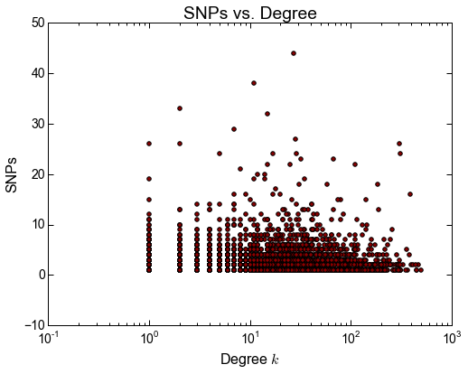
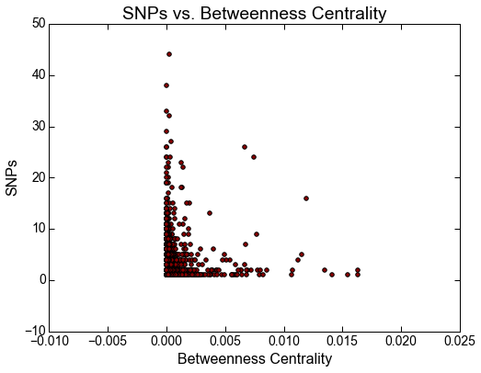
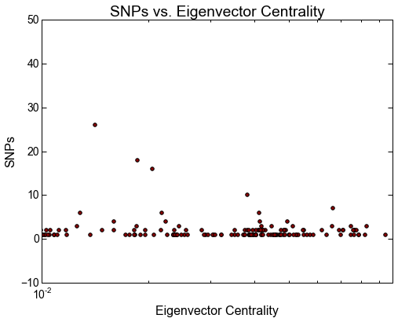
Gene | SNP Association pt. 1
Horizontal axis according to PPI and vertical axis based on GWAS

Slide 6
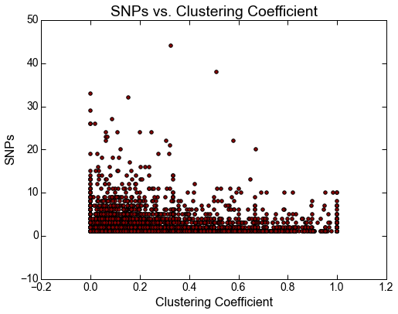
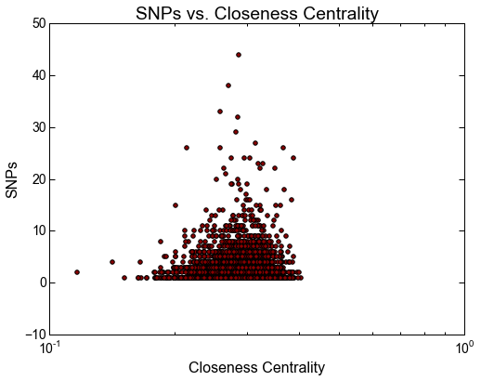
Gene | SNP Association pt. 2
Horizontal axis according to PPI and vertical axis based on GWAS

Slide 7
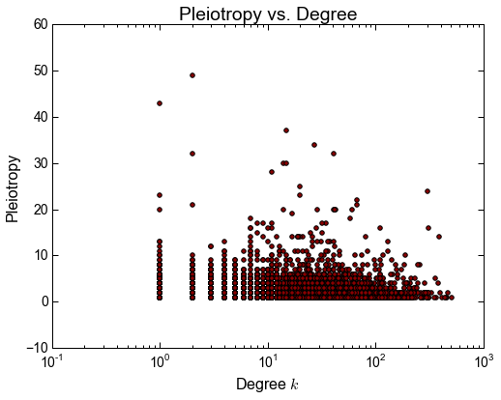
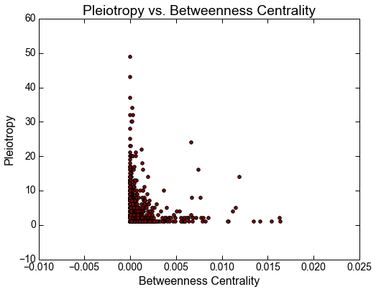
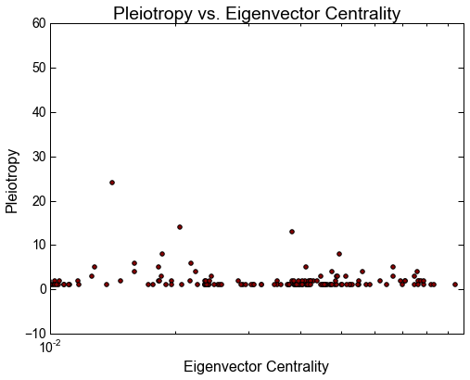
Gene | Pleiotropy pt. 1
Horizontal axis according to PPI and vertical axis based on GWAS

Slide 8
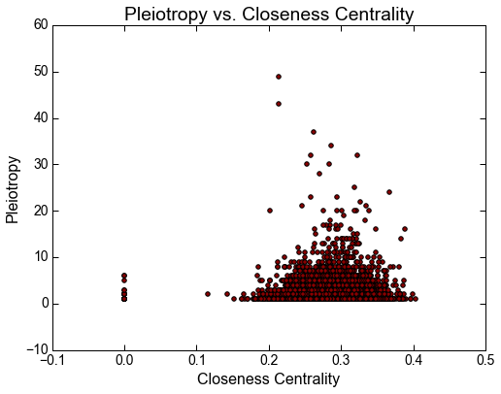
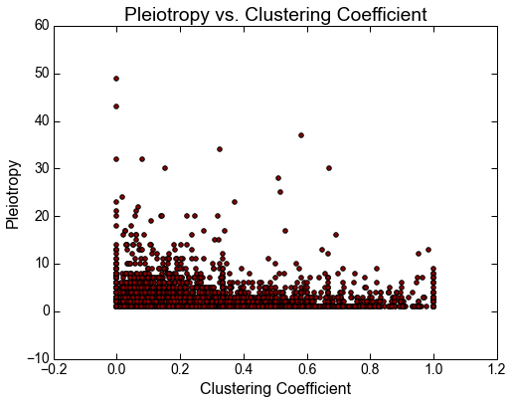
Gene | Pleiotropy pt. 2
Horizontal axis according to PPI and vertical axis based on GWAS

Slide 9
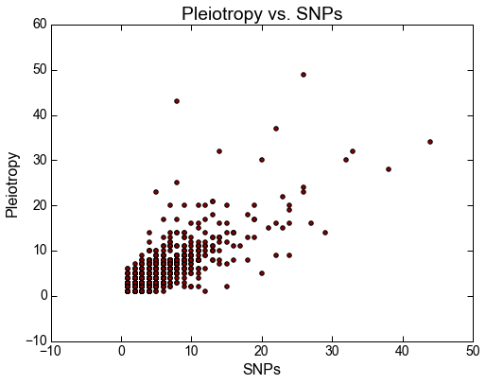
SNP | Pleiotropy
Genes with more SNPs have higher pleiotropy

Slide 10


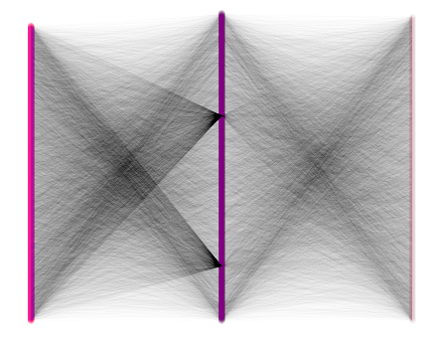
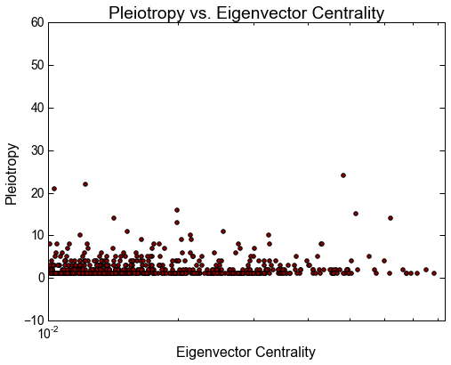
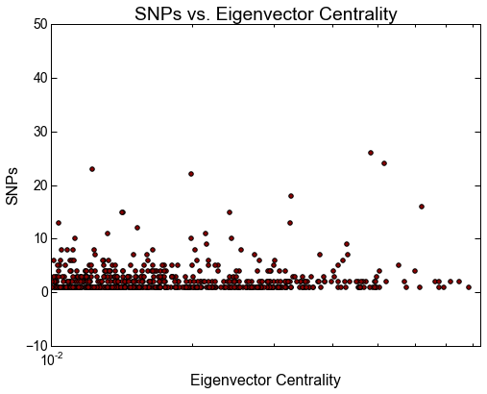
Null Model
Degree preserving randomization on the GWAS data will produce the same results.
Degree preserving randomization on the PPI yields similar results.

Slide 11
Disease | Disease Relationships
Disease-Disease connections:
SNPs
Genes
Diseases
We pair diseases based on:
Shared genes (According to GWAS)
Links are weighted using Jaccard Similarity.
D 1
Gene x
D 1
D 2
D 2

Slide 12
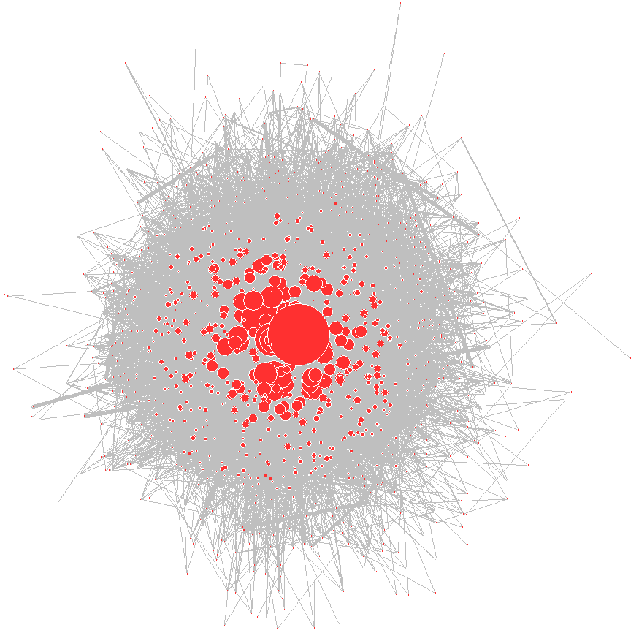
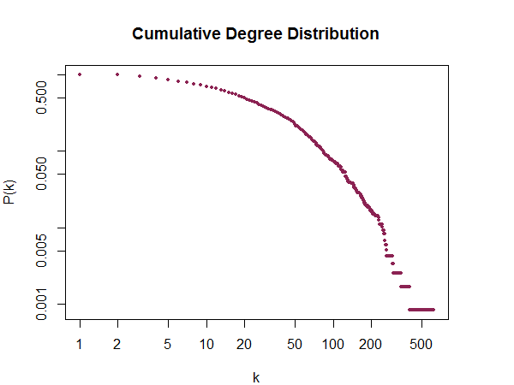
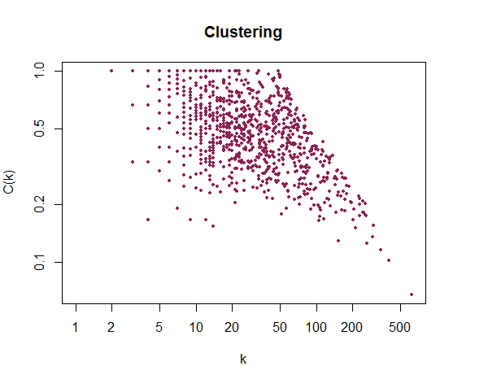
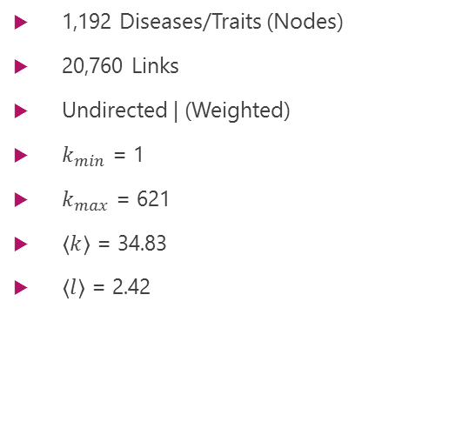
Disease | Disease Network
1,192 Diseases/Traits (Nodes)
20,760 Links
Undirected | (Weighted)
$k_{min}$ = 1
$k_{max}$ = 621
$\left\langle k\right\rangle$ = 34.83
$\left\langle l\right\rangle$ = 2.42
Links weighted using jaccard similarity here
Node sizes based on degrees

Slide 13
Top 50 Traits/Diseases Based on Degrees

Slide 14
References
[1] https://neuroendoimmune.wordpress.com/2014/03/27/dna-rna-snp-alphabet-soup-or-an-introduction-to-genetics/
[2] https://commons.wikimedia.org/wiki/File:Difference_DNA_RNA-EN.svg/

